Slide 1


Saba
15th of Jan 2023

Slide 2

Outline
Executive Summary
Introduction
Methodology
Results
Conclusion

Slide 3
Executive Summary
Summary of methodologies
Data Collection through API
Data Collection with Web Scraping
Data Wrangling
Exploratory Data Analysis with SQL
Exploratory Data Analysis with Data Visualization
Building an interactive map with Folium
Building a dashboard with Plotly Dash
Predictive analysis
Summary of all results
Exploratory Data Analysis results
Interactive analytics demo in screenshots
Predictive Analytics result

Slide 4
Introduction
Project background and context
SpaceX is the most successful company of the commercial space age, making space travel affordable. The company advertises Falcon 9 rocket launches on its website with a cost of 62 million dollars; other providers cost upward of 165 million dollars each, much of the savings is because Space X can reuse the first stage. Therefore, if we can determine if the first stage will land, we can determine the cost of a launch. This information can be used if an alternate company wants to bid against space X for a rocket launch. Based on public information and machine learning models, we are going to predict if SpaceX will reuse the first stage.
Problems you want to find answers
How do variables such as payload mass, launch site, number of flights or orbit affect the success of the first stage of landing?
What is the best algorithm that can be used for binary classification in this case?
Does the rate of successful landings increase over the years?

Slide 5


Slide 6
Methodology
Executive Summary
Data collection methodology:
Using SpaceX API
Using web scraping from Wikipedia.
Perform data wrangling
Dealing with missing value and filtering the data
Using One Hot Encoding to prepare the data to a binary classification
Perform exploratory data analysis (EDA) using visualization and SQL
Perform interactive visual analytics using Folium and Plotly Dash
Perform predictive analysis using classification models
How to build, tune, evaluate classification models to ensure the best results

Slide 7
Data Collection
Get HTML response from Wikipedia
Make dataframe
Export data
Extract data with BeautifulSoup
The data was collected using SpaceX REST API and webscrapping Wikipedia
The information obtained by the API are rocket , launches, payload information
The SpaceX REST API URL is : https://api.spacexdata.com/v4/launches/past
The information collected by webscrapping of Wikipedia are launches, landing and payload information
Call SpaceX REST API
API returns JSON file
Make Dataframe from JSON
Clean data and export it

Slide 8
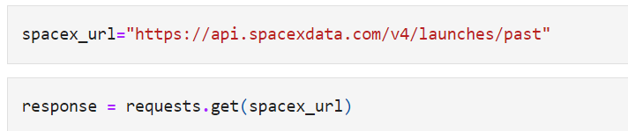
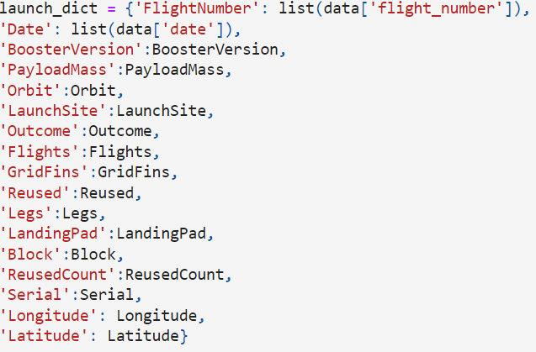
Data Collection – SpaceX API
Getting Response from API
Convert Response to JSON file
Apply custom function to clean data
Assign list to dictionary then dataframe
Filter Dataframe and Export to csv file
GitHub URL here: https://github.com/sabacoursera/IBM-Capstone-Project/blob/master/data%20collection.ipynb

Slide 9
Data Collection - Scraping
Request Falcon 9 launch data from Wikipedia
Create a BeautifulSoup object from the HTML response
Extract all column names from the HTML table header
Collect the data by paring HTML Tables
Export the data to csv
Create a dataframe from the dictionary
Construct data into a dictionary
GitHub URL: https://github.com/sabacoursera/IBM-Capstone-Project/blob/master/data%20scraping.ipynb

Slide 10
Data Wrangling
In the data set, there are several different cases where the booster did not land successfully:
True Ocean, True RTLS and True ADS mean the mission has been successful.
False Ocean, False RTLS , False ASDS mean the mission was a failure.
We performed multiple exploratory data analyses and determined training labels:
Calculate the number of launches on each site
Calculate the number and occurrence of each orbit
Calculate the number of mission outcome per orbit type
Create a landing outcome label from Outcome column and export to csv:
Github URL : https://github.com/sabacoursera/IBM-Capstone-Project/blob/master/data%20wrangling.ipynb
We need to transform string variables into categorical variables where 1 means the mission was a success and 0 means the mission was a failure.
Notes:
Calculate the number of launches on each site

Slide 11
EDA with Data Visualization
We explored the data by visualizing the relationship between variables using different chart types:
Scatter plot : flight number vs payload mass, flight number vs launch site, payload mass vs launch site, flight number vs orbit type, payload mass vs orbit type.
Bart chart: success rate of each orbit type
Line chart : the launch success yearly trend.
Github URL: https://github.com/sabacoursera/IBM-Capstone-Project/blob/master/Exploratory%20using%20pandas%20and%20marplot.ipynb

Slide 12
EDA with SQL
We loaded the SpaceX dataset into a SQL database and connectd to the jupyter notebook to run queries such as :
The names of unique launch sites in the space mission.
The total payload mass carried by boosters launched by NASA (CRS)
The average payload mass carried by booster version F9 v1.1
The total number of successful and failure mission outcomes
The failed landing outcomes in drone ship, their booster version and launch site names.
Github URL: https://github.com/sabacoursera/IBM-Capstone-Project/blob/master/exploratory%20using%20sql.ipynb

Slide 13
Build an Interactive Map with Folium
Markers, circles, line and marker clusters were used with Folium maps
Markets indicate points like launch sites
Circles indicate highlighted areas around specific coordinates, like NASA Johnson Center
Market clusters indicate groups of evets in each coordinate, like launches in a launch site
Lines are used to indicate distance between 2 coordinates
Github URL: https://github.com/sabacoursera/IBM-Capstone-Project/blob/master/Visual%20Analytics%20with%20Folium%20lab.ipynb

Slide 14
Predictive Analysis (Classification)
Create a Numpy array from the column ‘Class’ in data
Standardize the data, then fit and transform it
Split the data into training and test sets
Create a GridSearchCV object with cv=10 to find the best parameters
Find the methods which performs best by examining the Jaccard_score and F1_score metrics
Examine the confusion matrix for all models
Calculate the accuracy on the test data using the method.score() for all models
Apply GridSearchCV on LogReg, SVM, Decision Tree and KNN Models
GitHub URL: https://github.com/sabacoursera/IBM-Capstone-Project/blob/master/machine%20learning%20predictions.ipynb

Slide 15
Results
Exploratory data analysis results
Interactive analytics demo in screenshots
Predictive analysis results

Slide 16


Slide 17
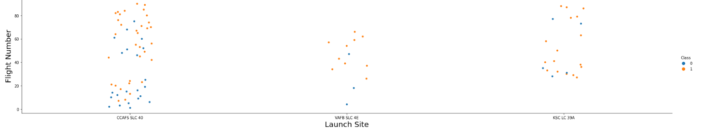
Flight Number vs. Launch Site
From the plot, we found that the earliest flights all failed while the latest flight all succeeded
KSC LC-39A and VAFB SLC 4E have higher success rates

Slide 18
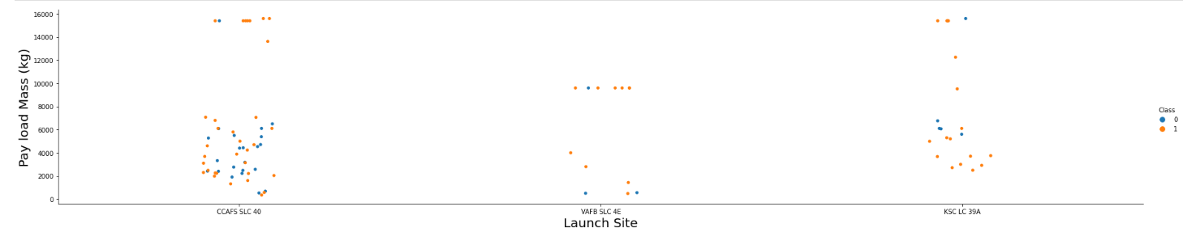
Payload vs. Launch Site
For the VAFB-SLC launch site there are no rockets launched for heavy payload mass, greater than 10000 kg.

Slide 19
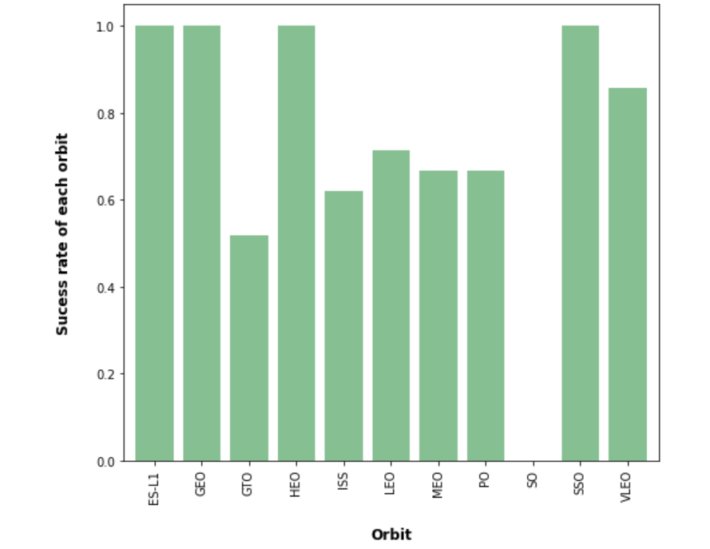
Success Rate vs. Orbit Type
ES-L1, GEO, HEO, SSO has highest Success rates. SO has poorest.

Slide 20
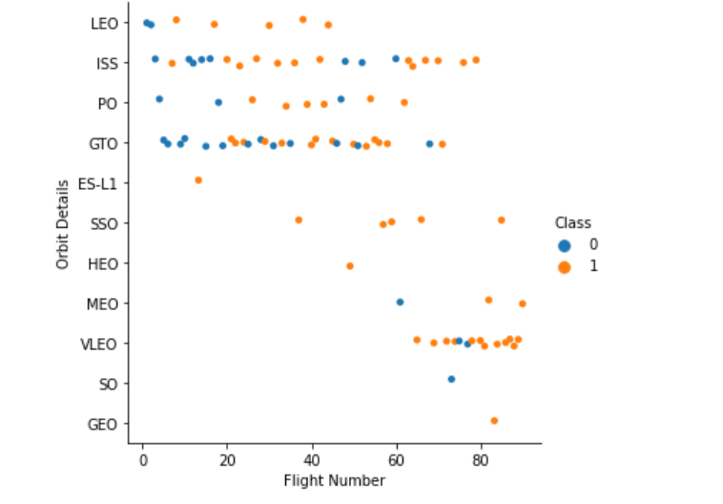
Flight Number vs. Orbit Type
In the LEO orbit the Success appears related to the number of flights; on the other hand, there seems to be no relationship between flight number when in GTO orbit.

Slide 21
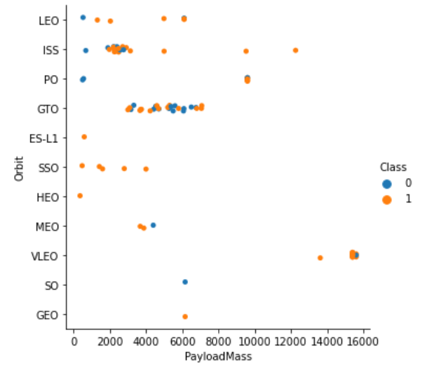
Payload vs. Orbit Type
We can observe that with heavy payloads, the successful landing are more for PO, LEO and ISS orbits. However for GTO we cannot distinguish this well as both positive landing rate and negative landing(unsuccessful mission) are both there here.

Slide 22
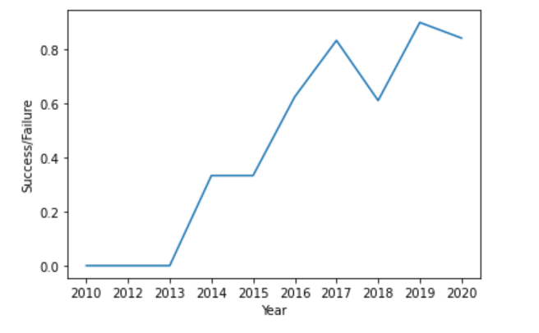
Launch Success Yearly Trend
From the plot, we can observe that success rate since 2013 kept on increasing till 2020.

Slide 23
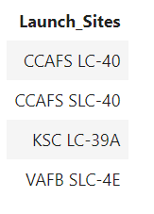
All Launch Site Names
We used the SQL Query to select distinct launch sites from SPACEXTBL to show only unique launch sites from the SpaceX data.

Slide 24
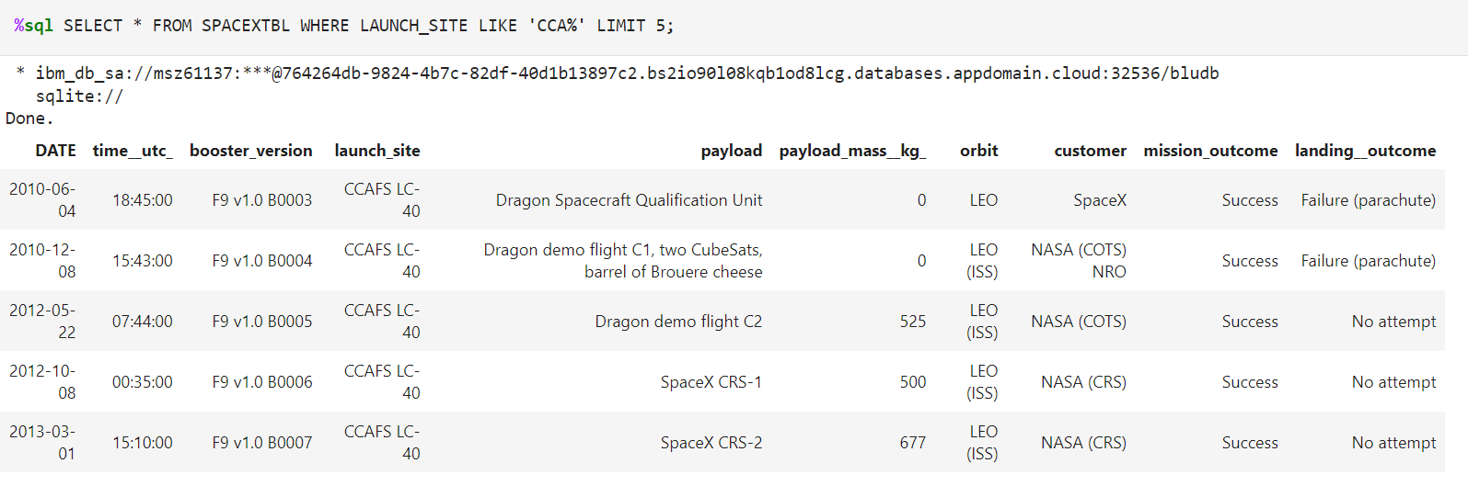
Launch Site Names Begin with 'CCA'
We used the query above to display 5 records where launch sites begin with `CCA`

Slide 25
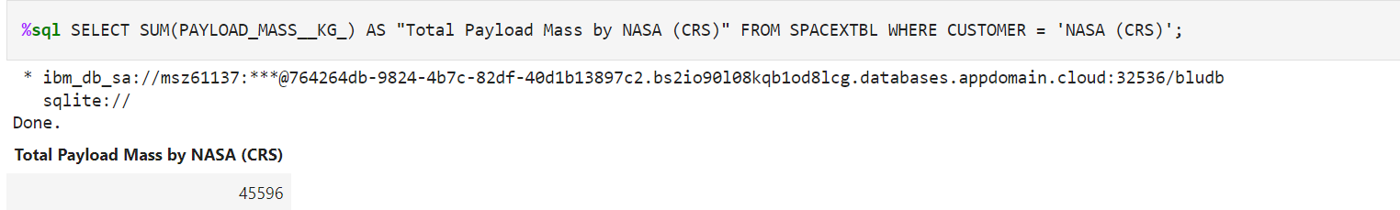
Total Payload Mass
We calculated the total payload carried by boosters from NASA as 45596 using the query below

Slide 26
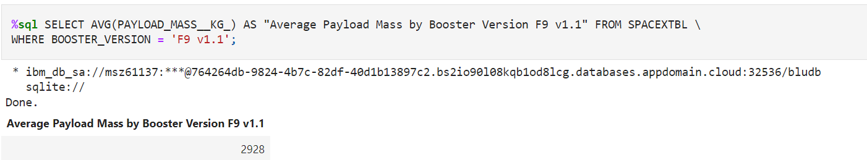
Average Payload Mass by F9 v1.1
We calculated the average payload mass carried by booster version F9 v1.1 as 2928.4

Slide 27
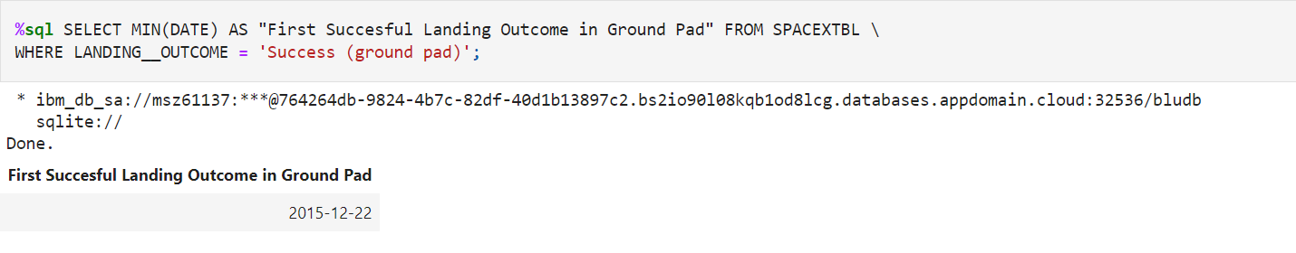
First Successful Ground Landing Date
We observed that the dates of the first successful landing outcome on ground pad was 22nd December 2015

Slide 28
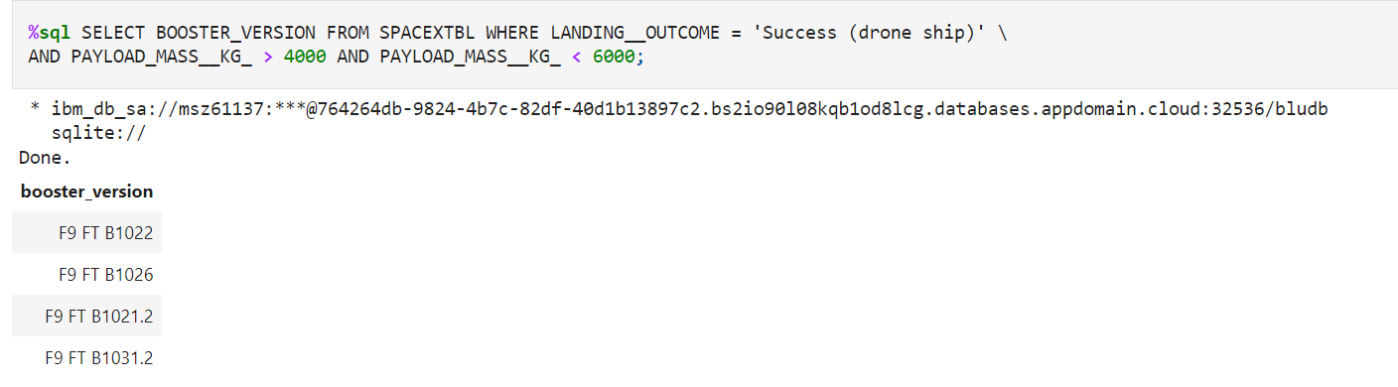
Successful Drone Ship Landing with Payload between 4000 and 6000
We used the WHERE clause to filter for boosters which have successfully landed on drone ship and applied the AND condition to determine successful landing with payload mass greater than 4000 but less than 6000

Slide 29
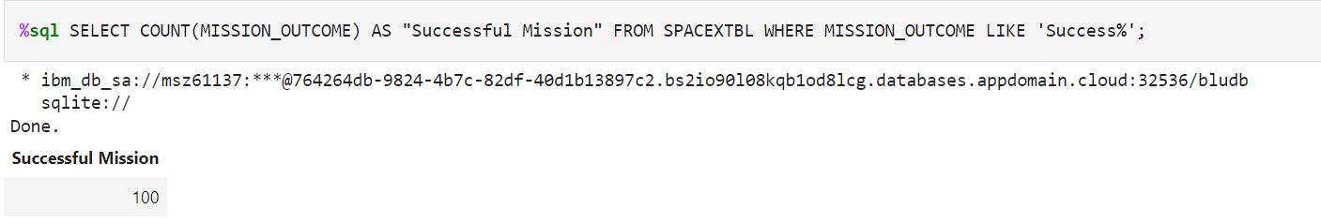
Total Number of Successful and Failure Mission Outcomes
We used wildcard like ‘%’ to filter for WHERE MissionOutcome was a success or a failure.

Slide 30
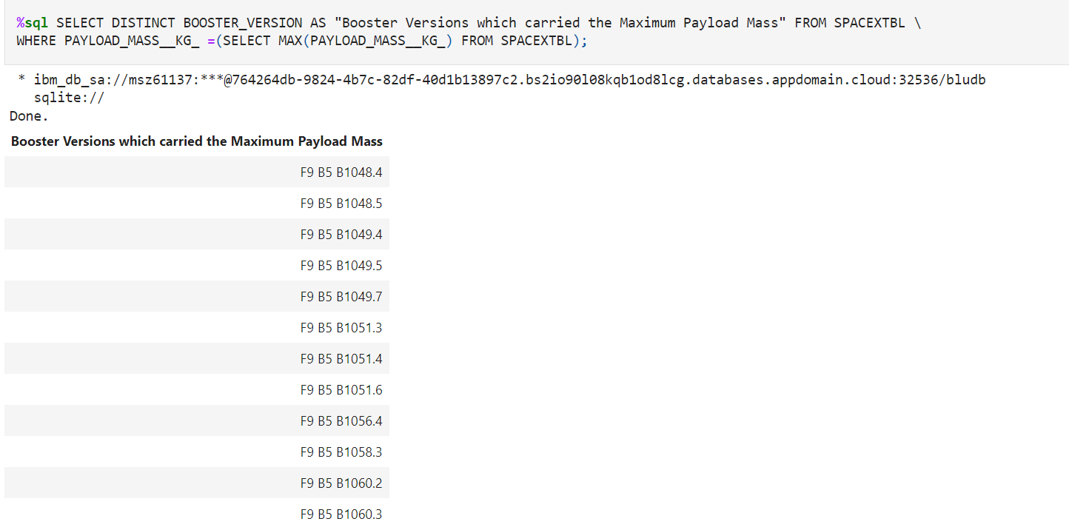
Boosters Carried Maximum Payload
We determined the booster that have carried the maximum payload using a subquery in the WHERE clause and the MAX() function.

Slide 31
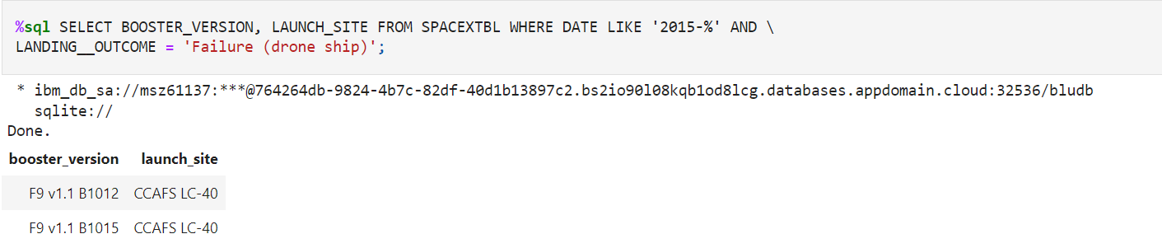
2015 Launch Records
We used a combinations of the WHERE clause, LIKE, AND, and BETWEEN conditions to filter for failed landing outcomes in drone ship, their booster versions, and launch site names for year 2015

Slide 32
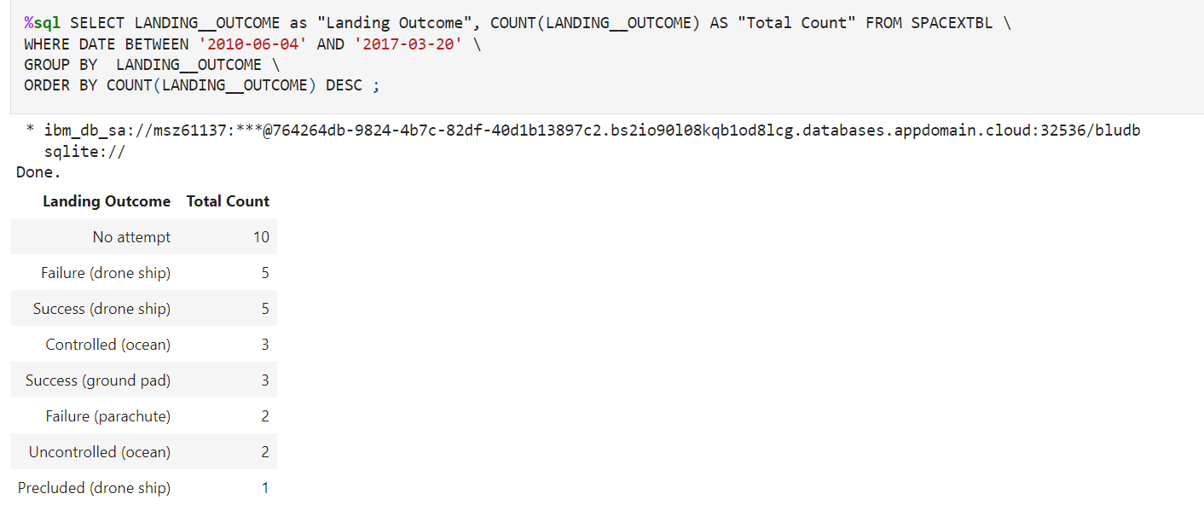
Rank Landing Outcomes Between 2010-06-04 and 2017-03-20
We selected Landing outcomes and the COUNT of landing outcomes from the data and used the WHERE clause to filter for landing outcomes BETWEEN 2010-06-04 to 2010-03-20.
We applied the GROUP BY clause to group the landing outcomes and the ORDER BY clause to order the grouped landing outcome in descending order.

Slide 33


Slide 34
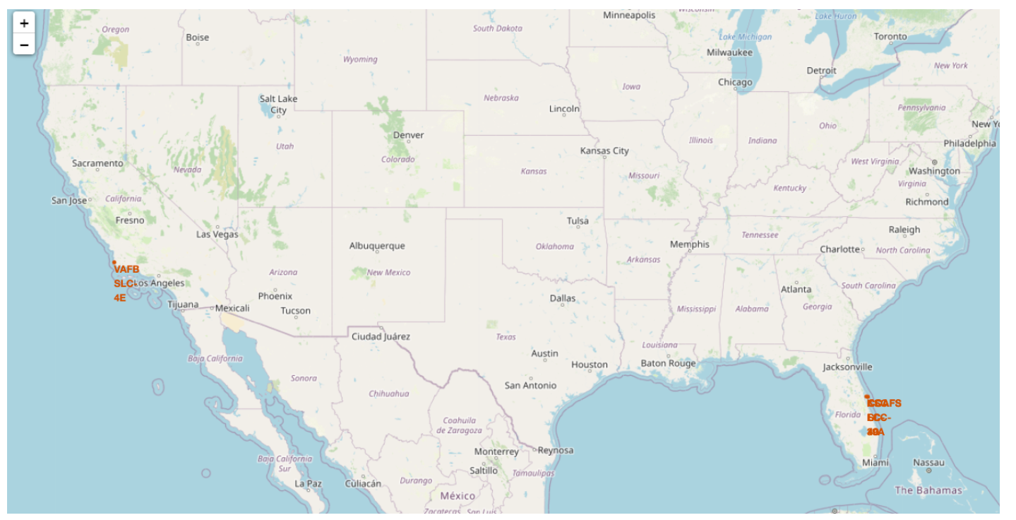
All launch sites global map markers
All launch sites are in very close proximity to the coast. The rocket would have the advantage of flying over the ocean, minimizing the risk of having any debris dropping or exploding near people.
Most of launch sites are in close proximity to the Equator line. If a spacecraft is launched from a site near Earth's equator, it can take optimum advantage of the Earth's substantial rotational speed. Sitting on the launch pad near the equator, it is already moving at a speed of over 1650 km per hour relative to Earth's center.

Slide 35
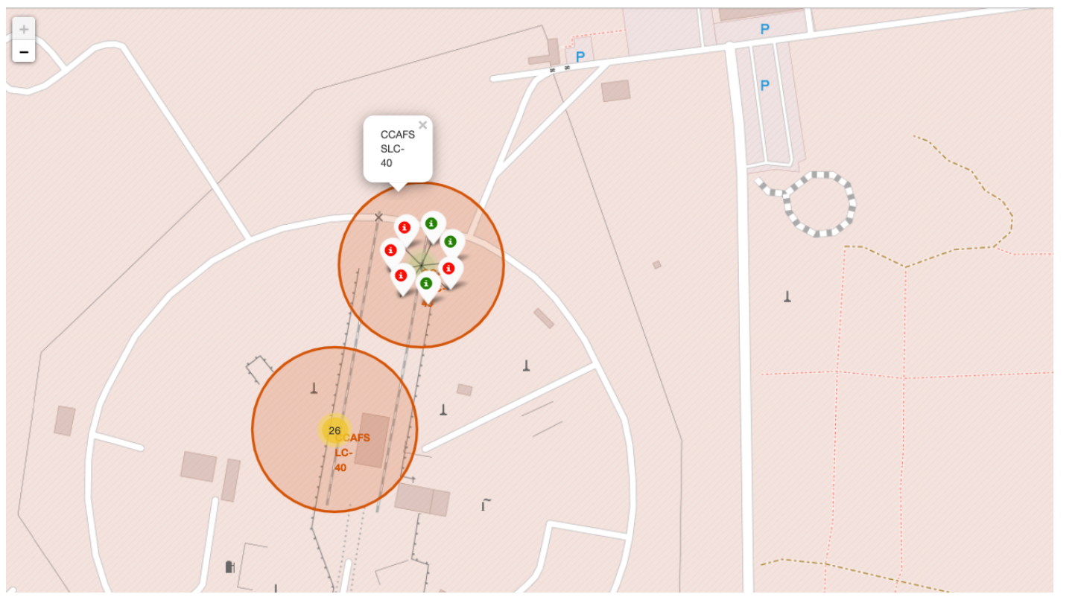
Color-labeled launch records on the map
Explanation:
We created markers for all launch records. If a launch was successful (class=1), then we used a green marker and if a launch was failed, we use a red marker (class=0)

Slide 36


Slide 37
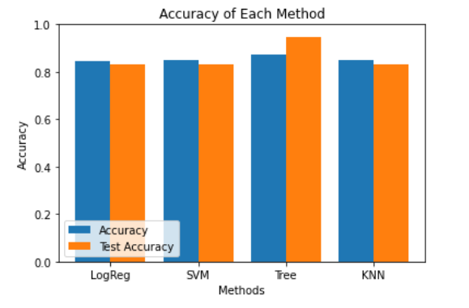
Classification Accuracy
Based on the scores of the Test Set, we can not confirm which method performs best. Same Test Set scores may be due to the small test sample size (18 samples) . Therefore, we tested all methods based on the whole Dataset. The scores of the whole Dataset confirm that the best model is the Decision Tree Model.

Slide 38
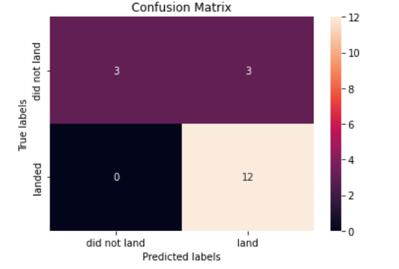
Confusion Matrix
The confusion matrix for the decision tree classifier shows that logistic regression can distinguish between the different classes. We see that the major problem is false positives.

Slide 39
Conclusions
We can conclude that:
The larger the flight amount at a launch site, the greater the success rate at a launch site.
Launch success rate started to increase in 2013 till 2020.
Orbits ES-L1, GEO, HEO, SSO had the most success rate.
KSC LC-39A had the most successful launches of any sites.
The Decision tree classifier is the best algorithm for this dataset
Most of the launch sites are in proximity of the Equator line and all the sites are in very close proximity to the coast

Slide 40


